Slide 1



Play Store App Review Analysis
View in Power BI
Last data refresh:
8/10/2024 9:42:07 PM UTC
Downloaded at:
8/10/2024 10:07:48 PM UTC

Slide 2
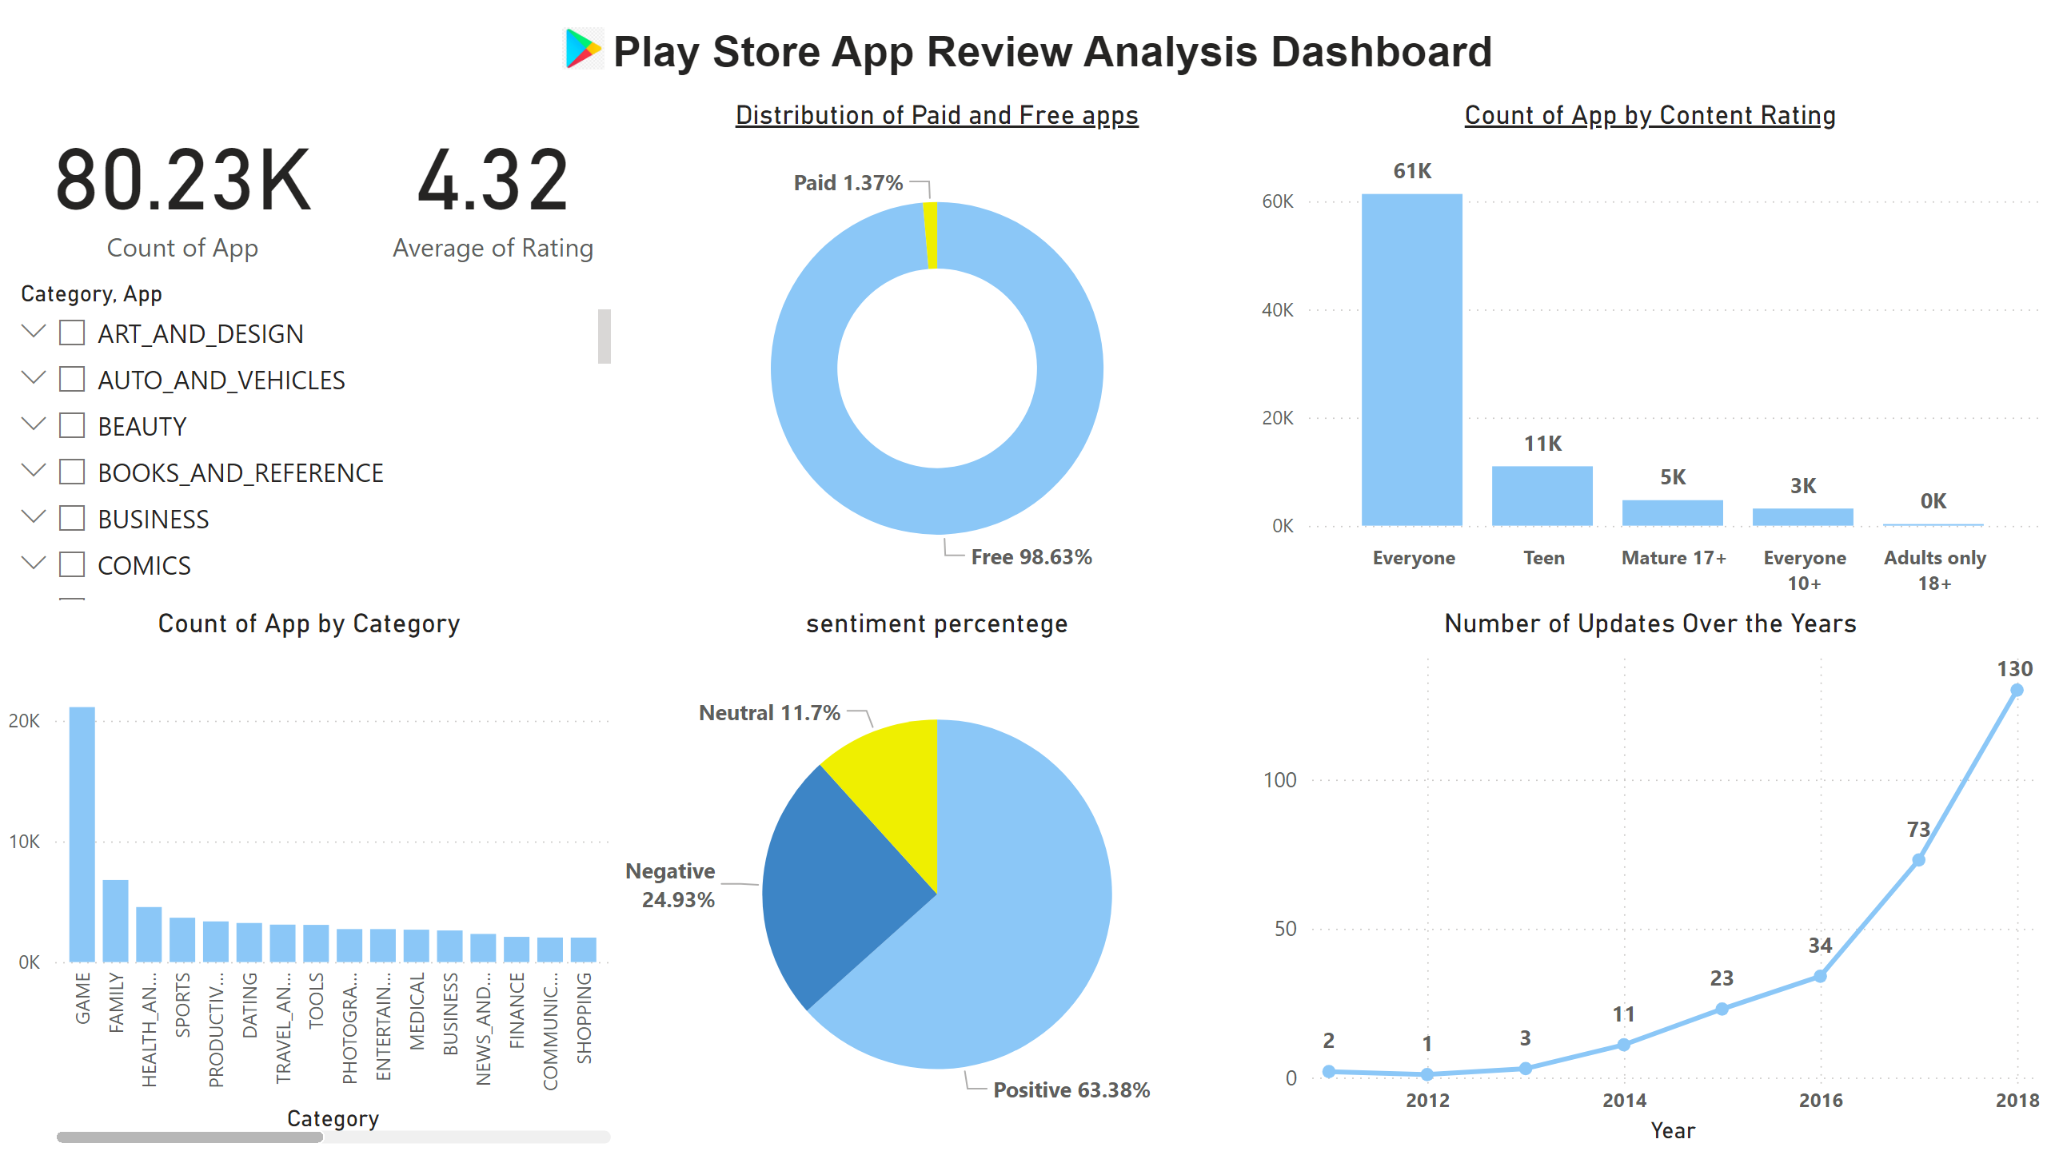
Page 6
Notes:
slicer
No alt text provided
clusteredColumnChart
No alt text provided
Distribution of Paid and Free apps
No alt text provided
textbox
No alt text provided
image
No alt text provided
sentiment percentege
No alt text provided
Number of Updates Over the Years
No alt text provided
card
No alt text provided
card
No alt text provided
columnChart
No alt text provided

Slide 3
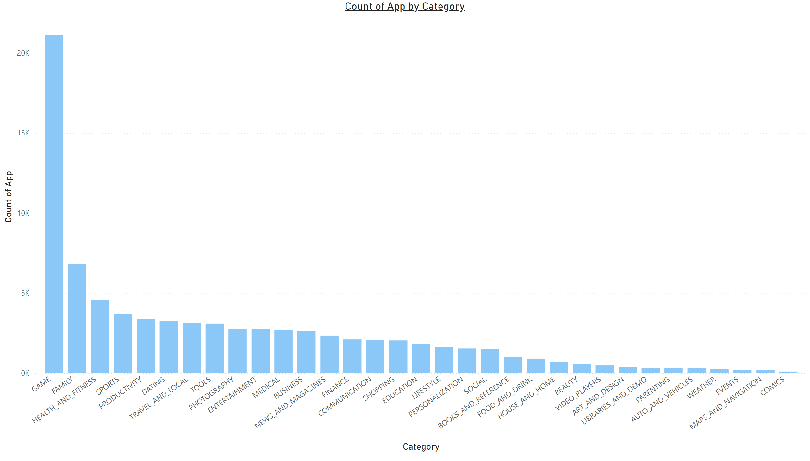
Page 1
Notes:
clusteredColumnChart
No alt text provided

Slide 4
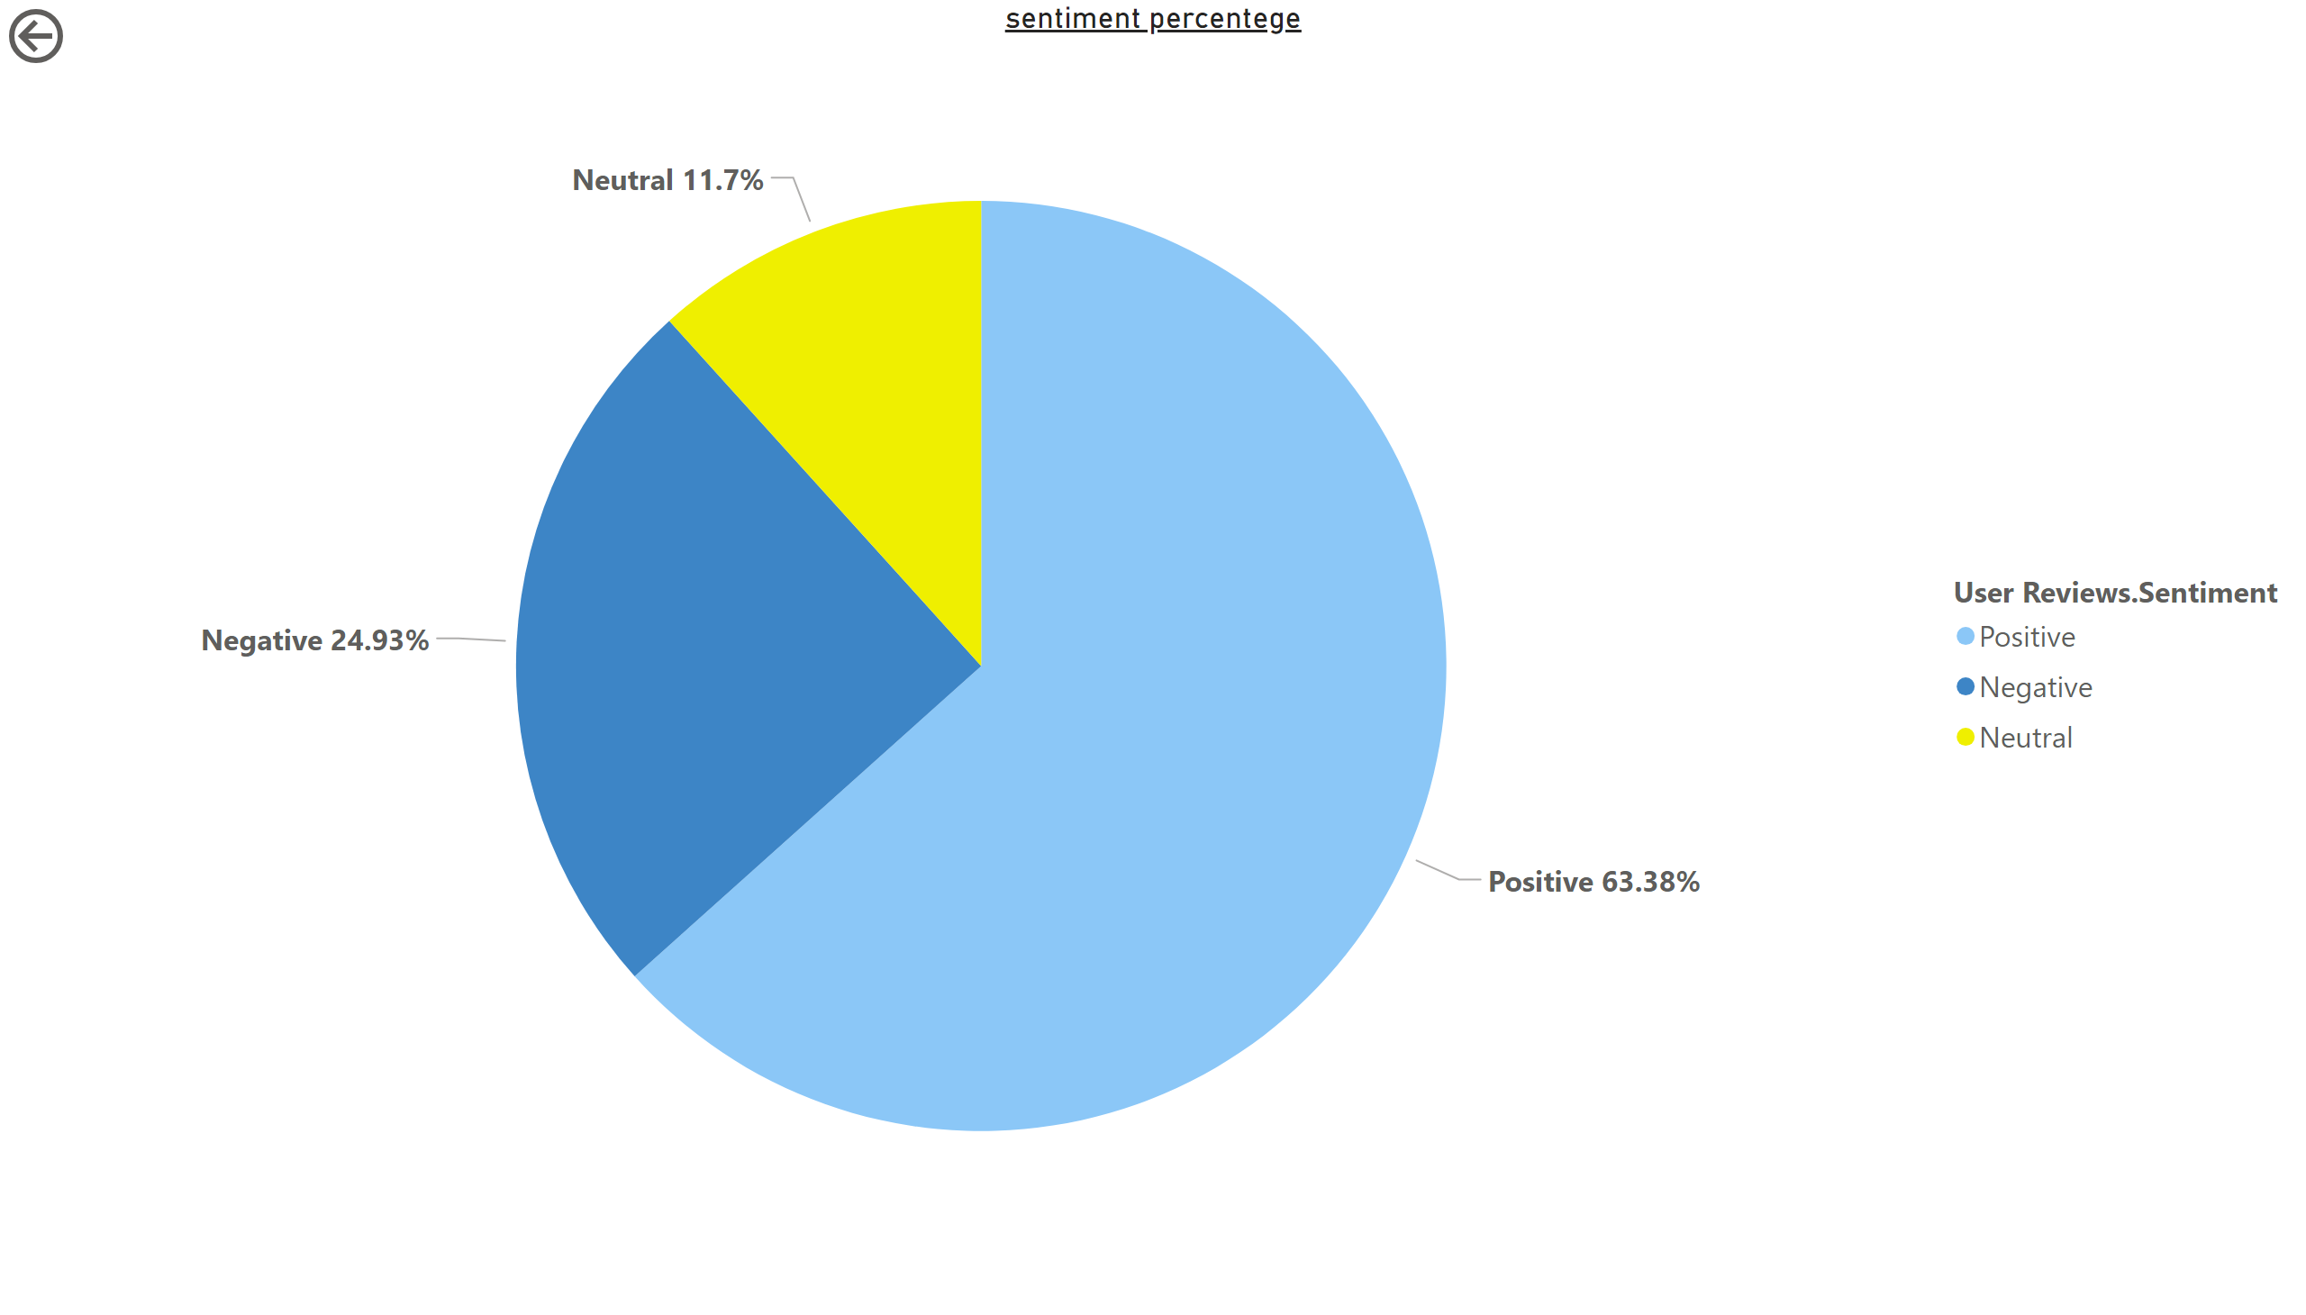
Page 2
Notes:
sentiment percentege
No alt text provided
actionButton
No alt text provided

Slide 5
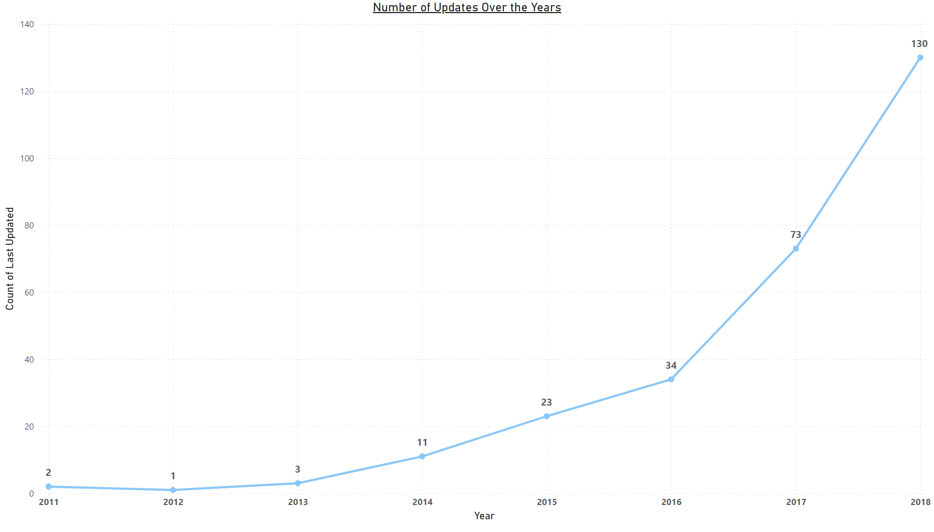
Page 3
Notes:
Number of Updates Over the Years
No alt text provided

Slide 6
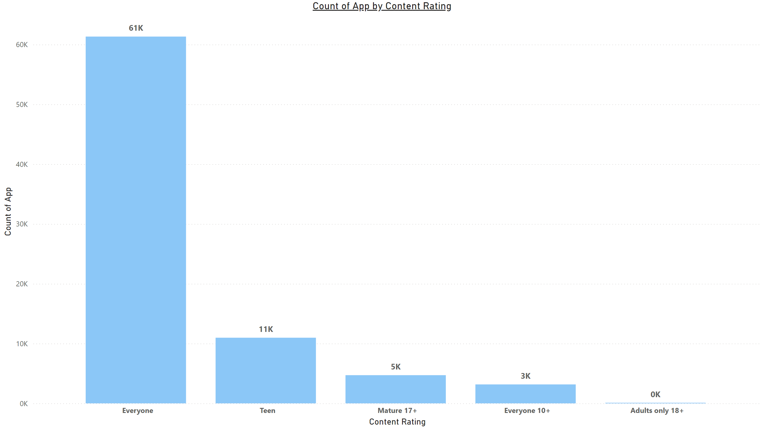
Page 4
Notes:
clusteredColumnChart
No alt text provided

Slide 7
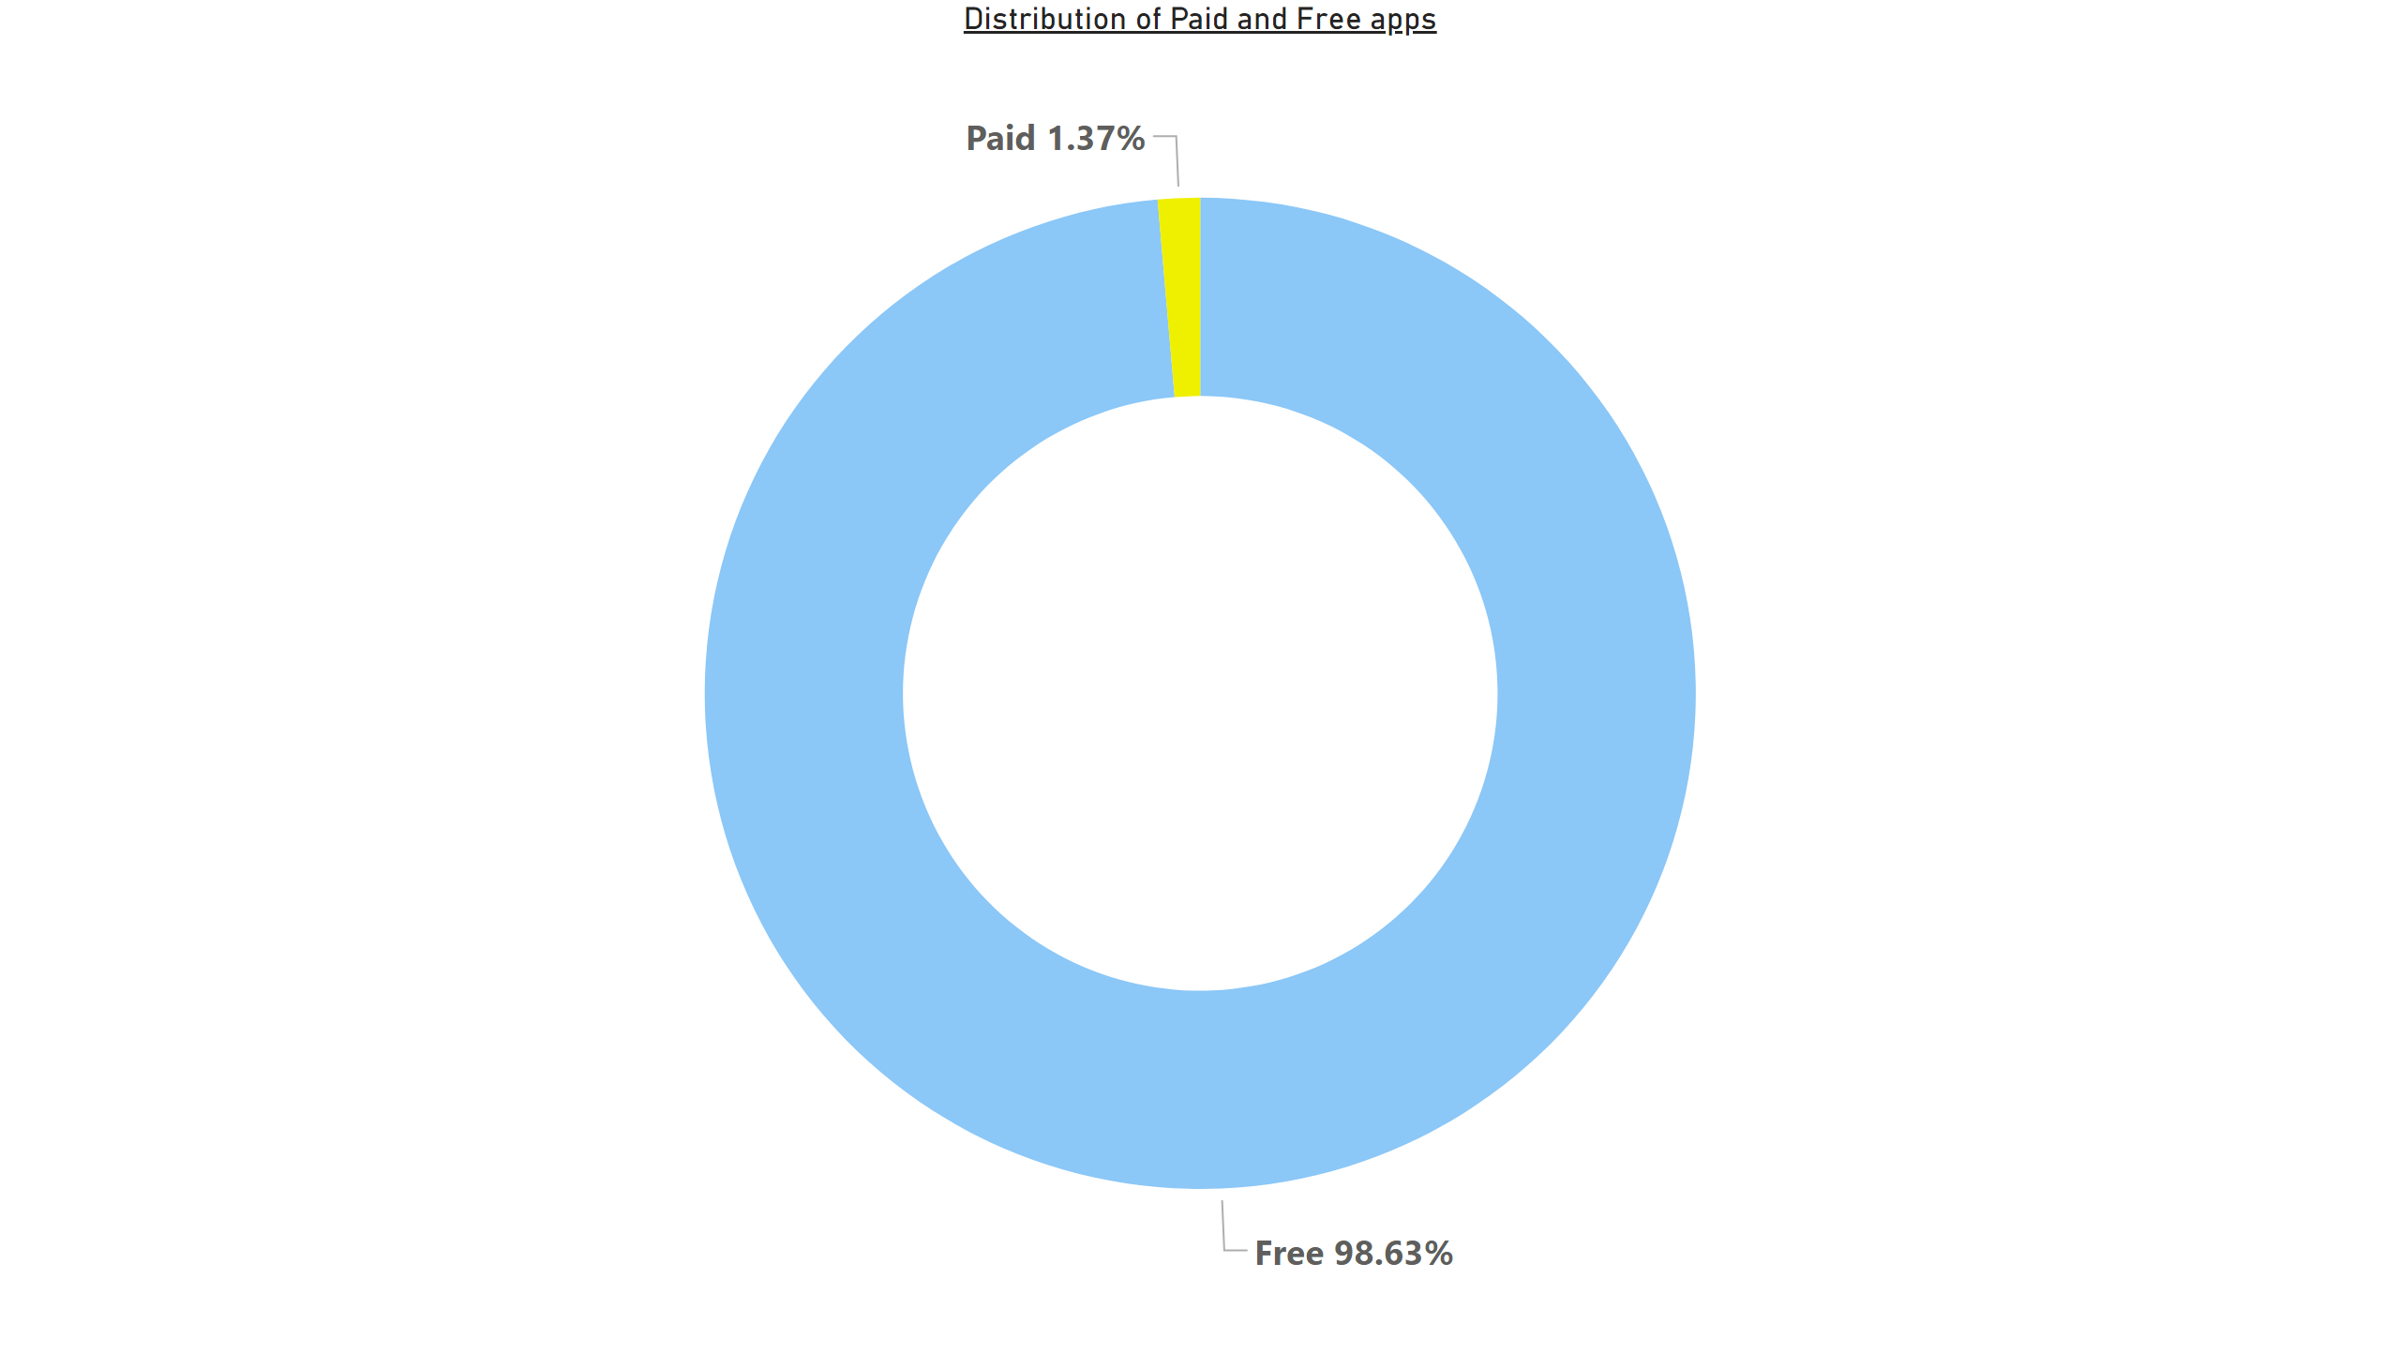
Page 5
Notes:
Distribution of Paid and Free apps
No alt text provided

